Slide 1
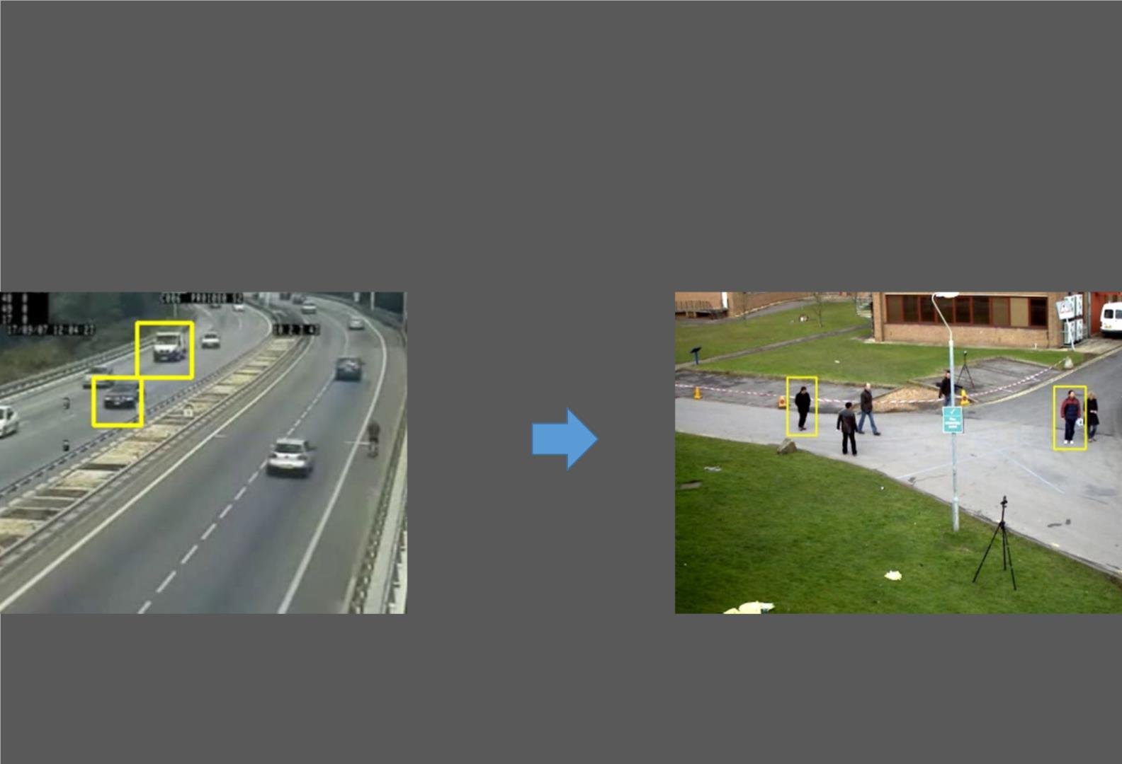
Major Project
Car and Pedestrian Detection

Slide 2

The Ar tificial Intelligence Dream
Machines that can see and understand the world around them
Source: Terminator 2: Judgement Day
However, Computer Vision is a Challenging!

Slide 3

Computer Vision is a cutting edge
field of Computer Science that
aims to enable computers to
understand what is being seen
in an image

Slide 4

Why is it so hard? So Many Reasons!
• Object class variations

Slide 5
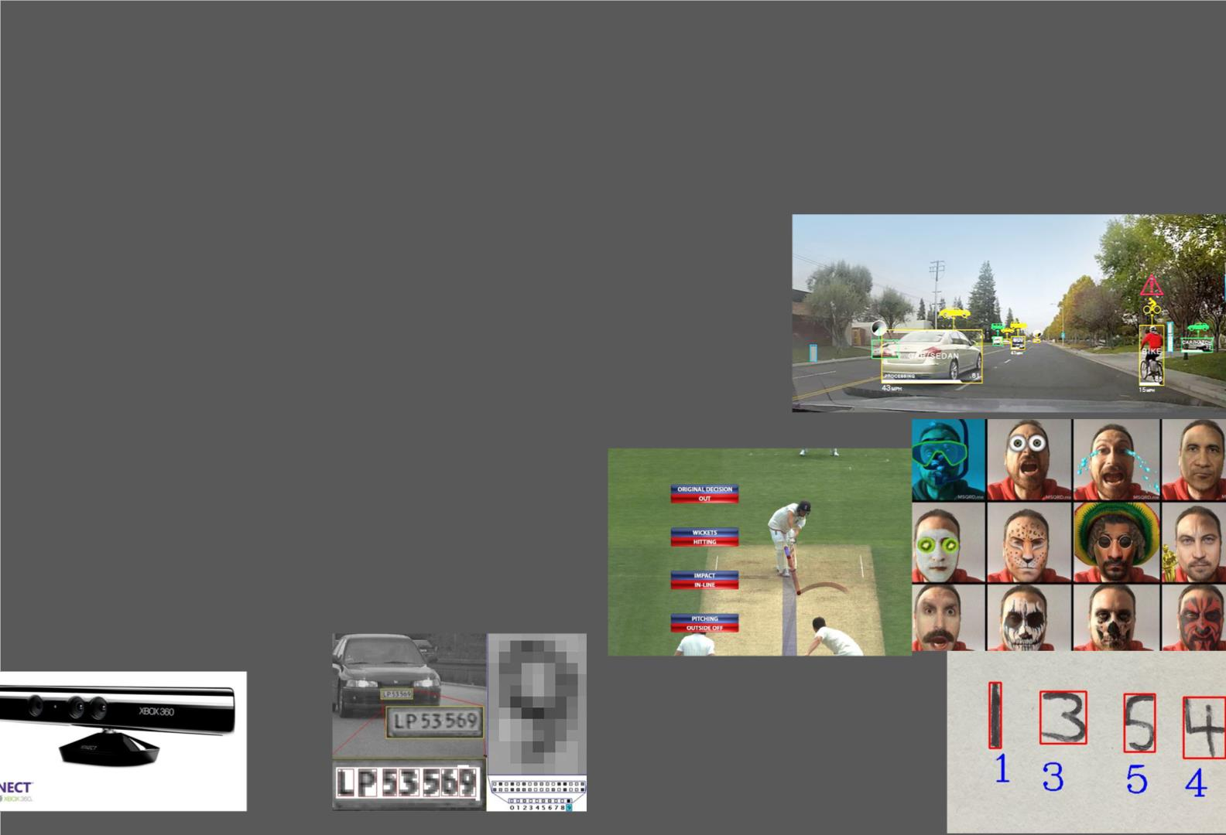
Despite the difficulty, Computer Vision scientists have had
many success stories!
Robotic Navigation – Self Driving Cars
Face Detection & Recognition
Search Engine Image Search
License Plate Reading
Handwriting Recognition
Snapchat & MSQRD Face Filters
Object Recognition
Ball & Player Tracking in Sports
And many more!

Slide 6

So why OpenCV in Python?
Python is one of the easiest languages for beginners
It is extremely powerful for data science and machine learning
applications
It stores images in numpy arrays which allows us to do some ver y
powerful operations quite easily

Slide 7

Requirements?
Basic programming is useful, but not needed I’ll walk you through most of the
code. Exposure to Numpy would be helpful.
High School Level Math
A Webcam
Python 2.7 or 3.6
• Anaconda Package is preferred but not required. I use Python 2.7, but all code works
in 3.6
• I use Python Notebooks which are excellent for teaching
OpenCV 2.14.6 & or 3.4.X
• Ideally we’d like to use the latest version OpenCV 3.4.6, however it is u missing some
important functions (SIFT, SURF etc.) that are included in 2.4.16. There are ways
around it however, so don’t despair.

Slide 8
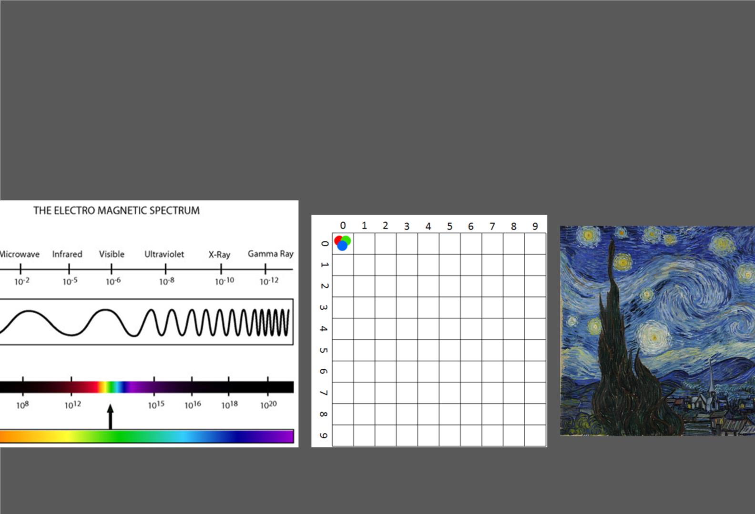
What are Images?
2-Dimensional representation of the visible light spectrum

Slide 9
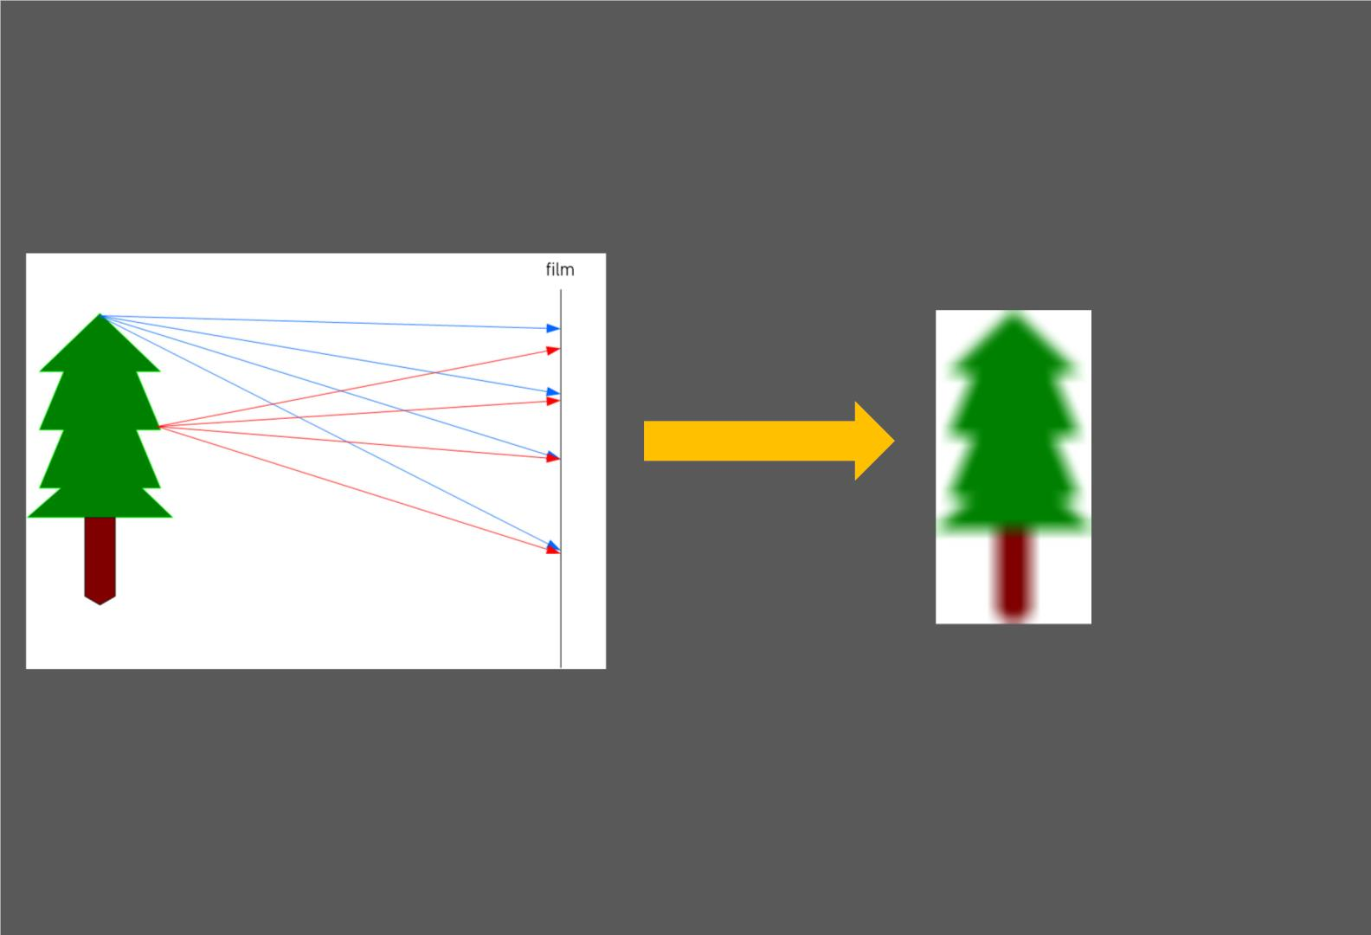
How are images formed
• When light reflects off an object onto a film, sensor or retina
• In the above example the image here will be blurred

Slide 10
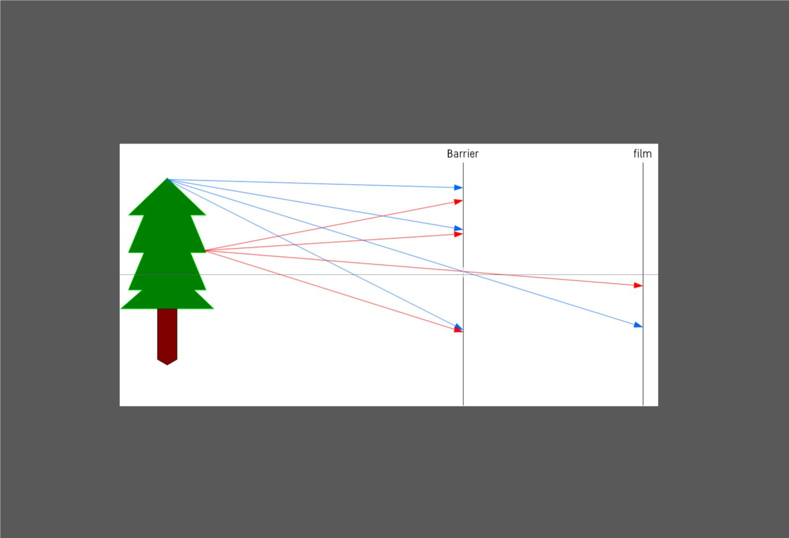
Image Formation
• Using a small opening in the barrier (called aperture), we block off most of the rays of light
reducing blurring on the film or sensor
• This is the pinhole camera model

Slide 11
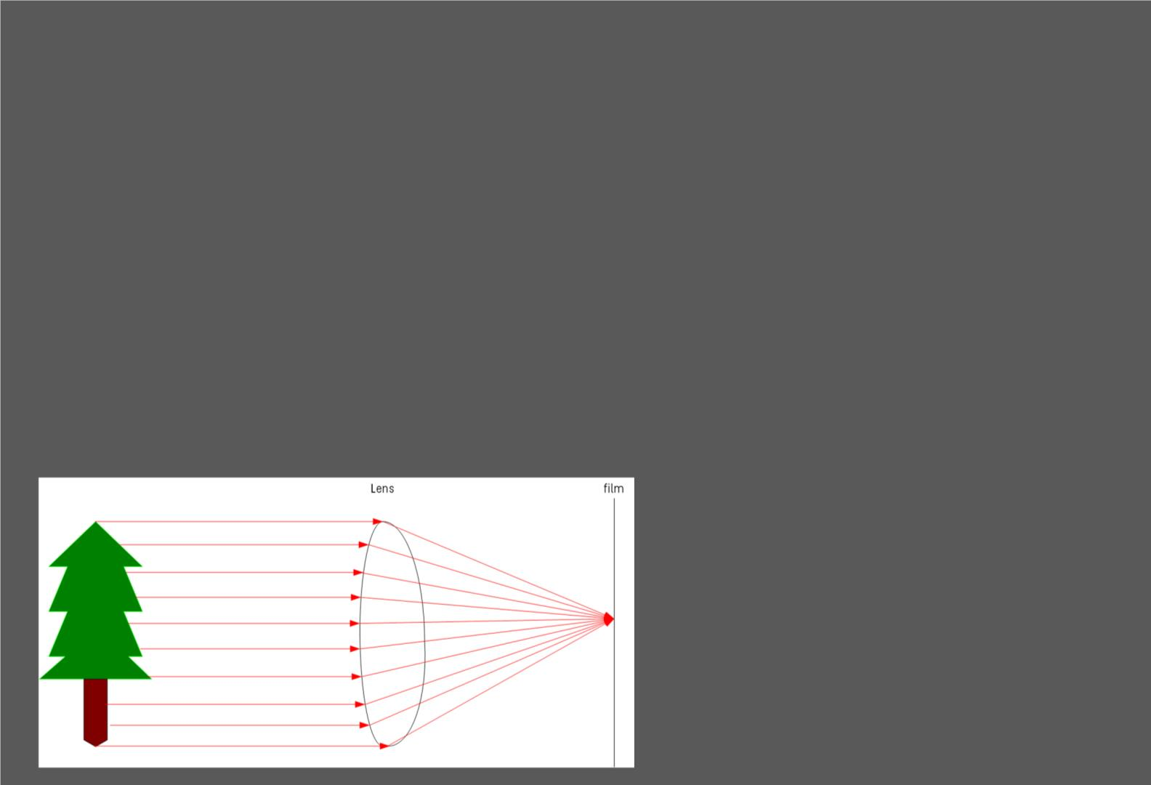
Controlling Image Formation with a Lens
Both our eyes and cameras use an adaptive lens to control many aspects of
image formation such as:
• Aperture Size
• Controls the amount of light allowed through (f-stops in cameras)
• Depth of Field (Bokeh)
• Lens width - Adjusts focus distance (near or far)

Slide 12
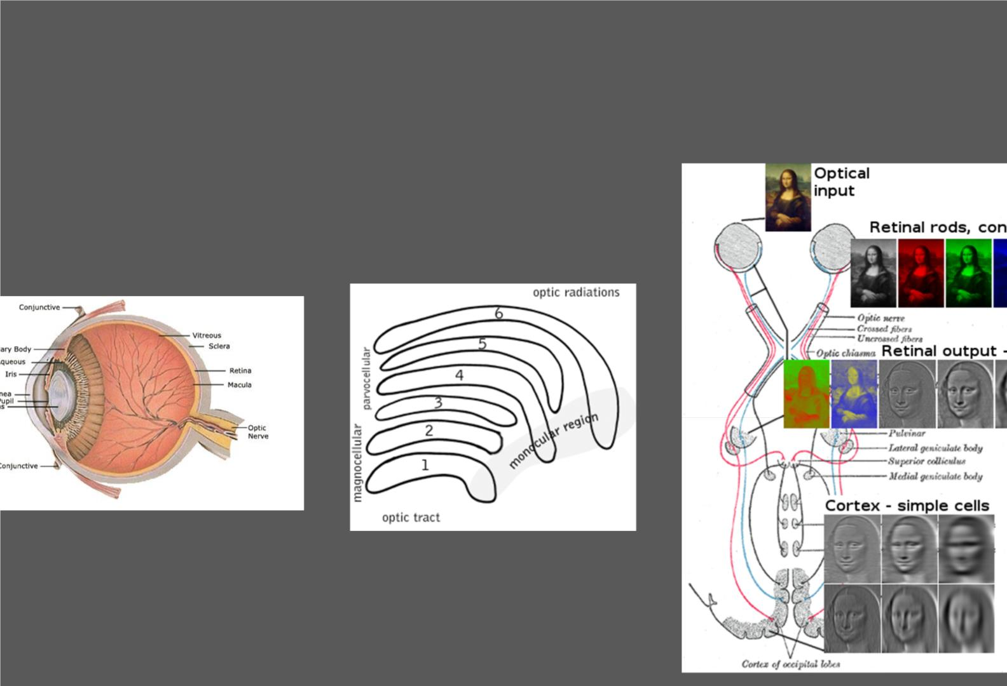
How Humans See
The human visual system (eye & visual cortex) is
incredibly good at image processing
eck out - https://en.wikipedia.org/wiki/Visual_system

Slide 13
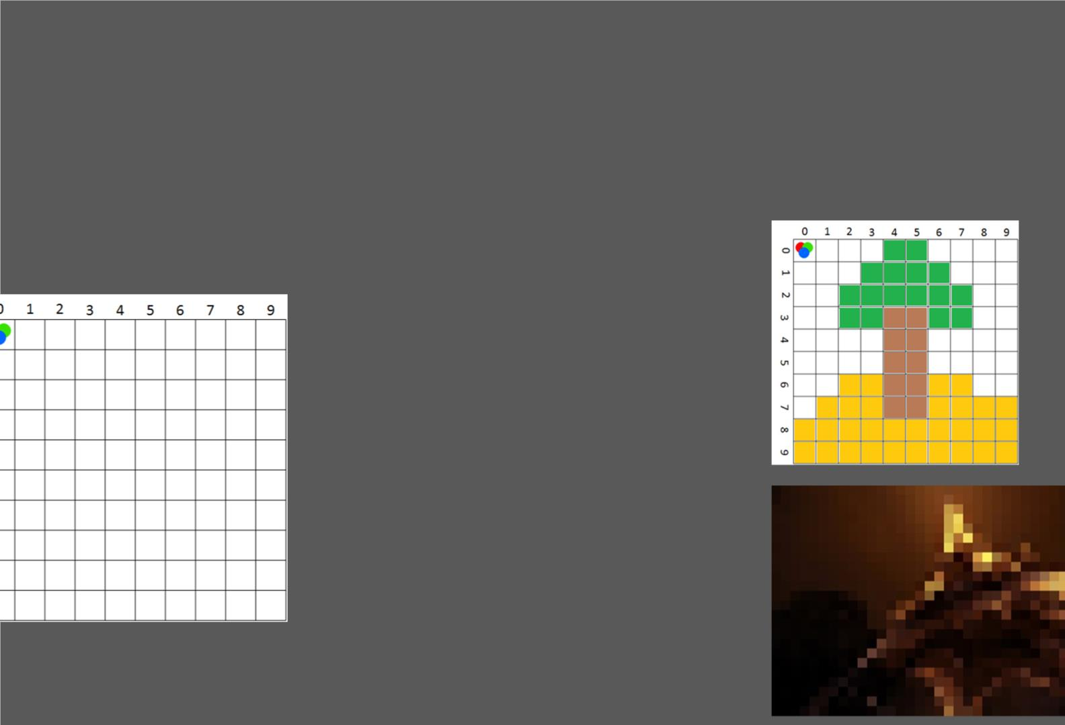
How do Computers store images?
OpenCV uses RBG color space by default.
Each pixel coordinate (x, y) contains 3
values ranging for intensities of 0 to
255 (8-bit).
•
•
•
Red
Green
Blue
Mixing different intensities of each
color gives us the full color spectrum,
example Yellow:
• Red – 255
• Green – 255
• Blue - 0

Slide 14
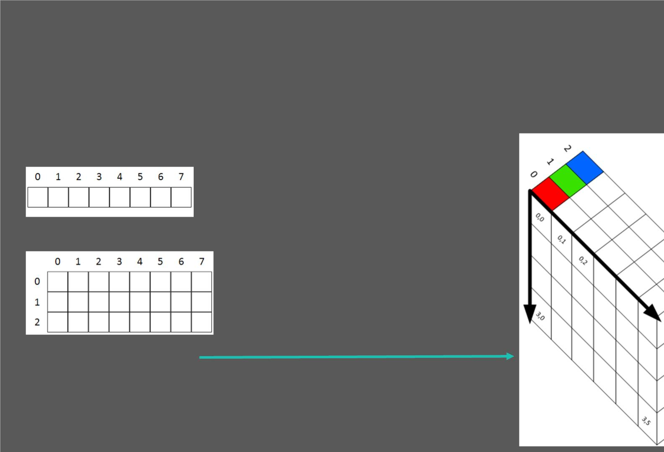
Images are stored in multi-dimensional arrays
Think of an array as table. A 1-dimensional arrays looks like this:
• A 2-dimensional array looks like this:
• 3-dimensional array

Slide 15

Black and White or Greyscale
Black and White images are stored in
2-Dimensional arrays
There are two types of B&W images
• Grayscale – Ranges of shades of
grey
• Binary – Pixels are either black or
white

Slide 16
What exactly is OpenCV
Officially launched in 1999, OpenCV (Open Source Computer Vision) from an Intel
initiative.
OpenCV is written in C++.
First major release 1.0 was in 2006, second in 2009 and third in 2015.
OpenCV 2.4.13 is latest stable release for OpenCV 2.X.
Open 3.X is ver y similar, and has some benefits and new functions, however, it also
removed some of the important algorithms (due to patents) such as SIFT & SURF.
You can Visit - opencv.org or wikipedia.org/wiki/OpenCV to learn more

Slide 17
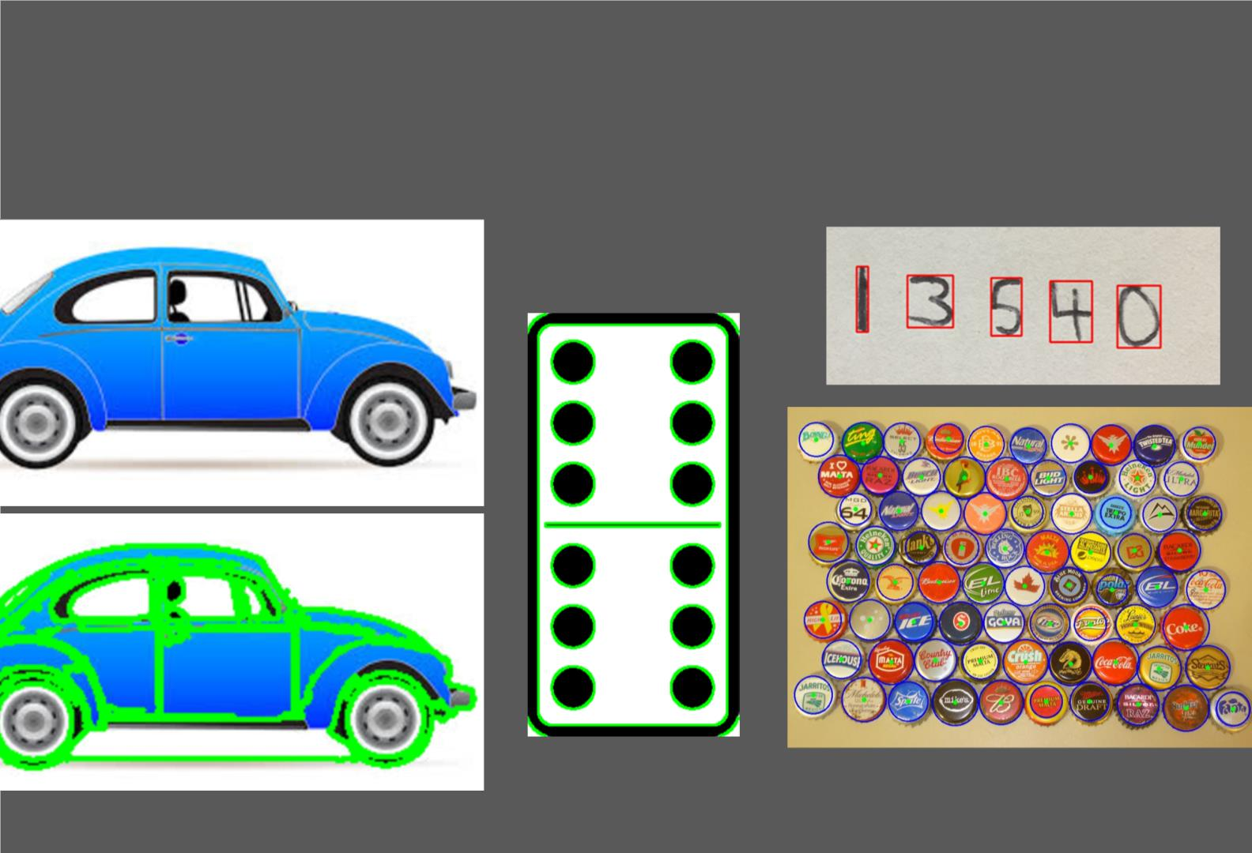
Segmentation - Partitioning images into different regions

Slide 18
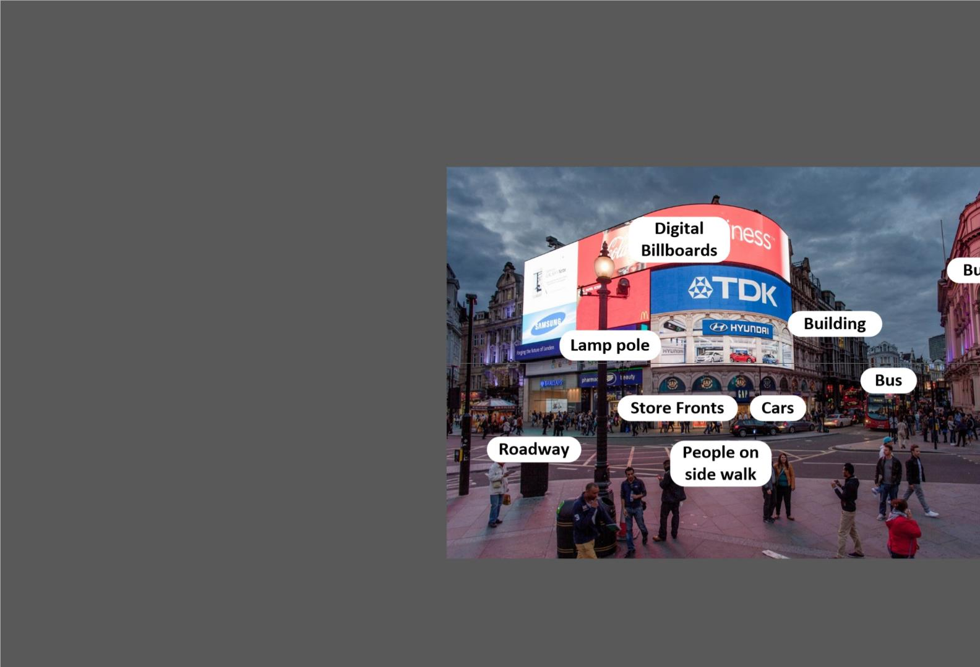
Object Detection
Why do we need detect objects in image?
Labeling Scenes
Robot Navigation
Self Driving Cars
Body Recognition (Microsoft Kinect)
sease & Cancer Detection
Facial Recognition
Handwriting Recognition

Slide 19

Let’s now get started making Project with OpenCV in Python.

Slide 20
Major Project
People & Car
Detection

Slide 21
People & Car Detection
Understanding HAAR Cascade Classifiers
Car Detection & Pedestrian (Body) Detection

Slide 22

HAAR Cascade Classifiers
What are HAAR Cascade Classifiers?
An object detection method that inputs Haar features into a series of classifiers (cascade) to identify objects in an image.
They are trained to identify one type of object, however, we can use several of them in parallel e.g. detecting eyes and
aces together.

Slide 23
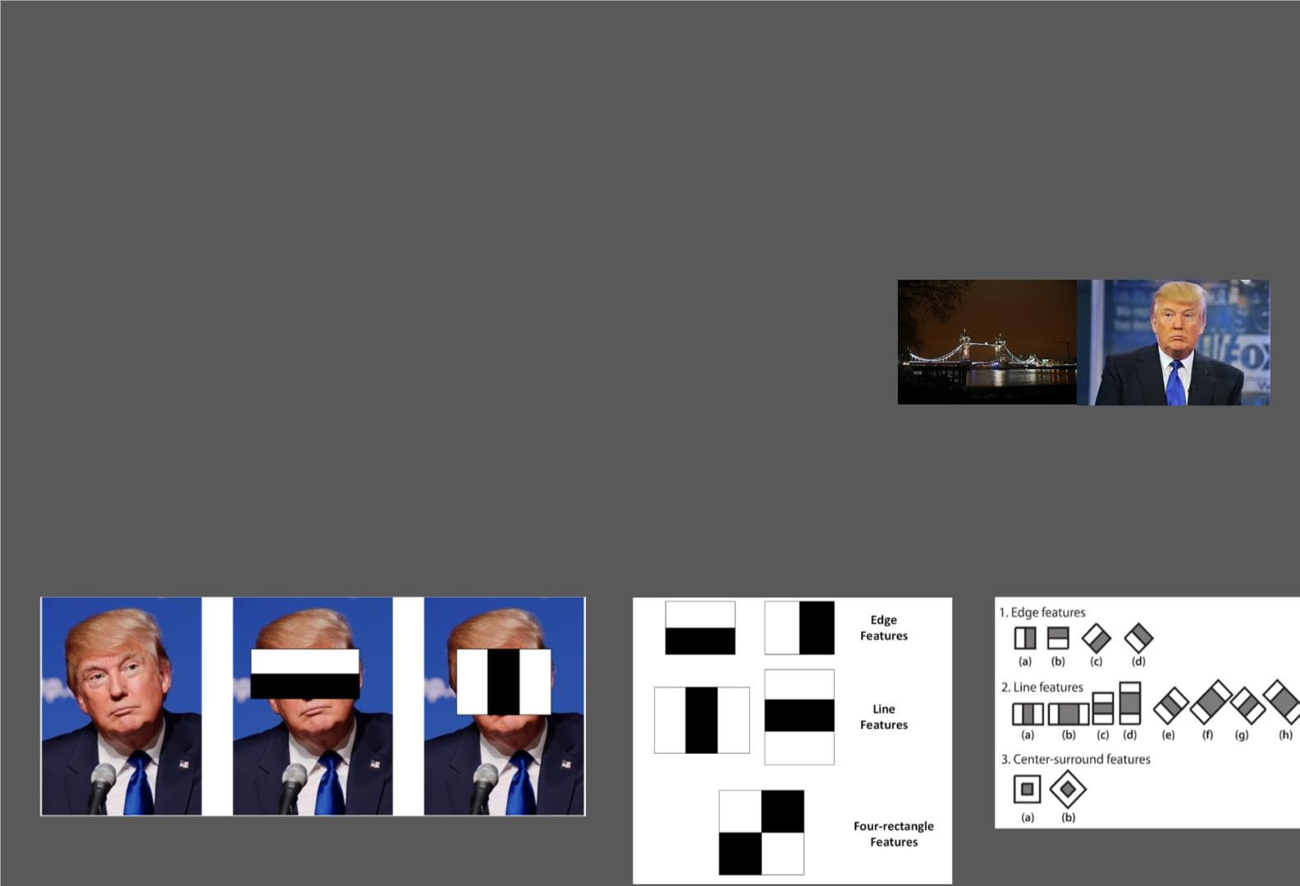
HAAR Classifiers Explained
HAAR Classifiers are trained using lots of positive images (i.e. images with the object present) and
negative images (i.e. images without the object present).
Negative
Positive
. We then extract features using sliding windows of rectangular blocks. These features are single valued
and are calculated by subtracting the sum of pixel intensities under the white rectangles from the black
rectangles. However, this is a ridiculous number of calculations, even for a base window of 24 x 24
pixels (180,000 features generated). So the researchers devised a method called Integral Images that
computed this with four array references.

Slide 24
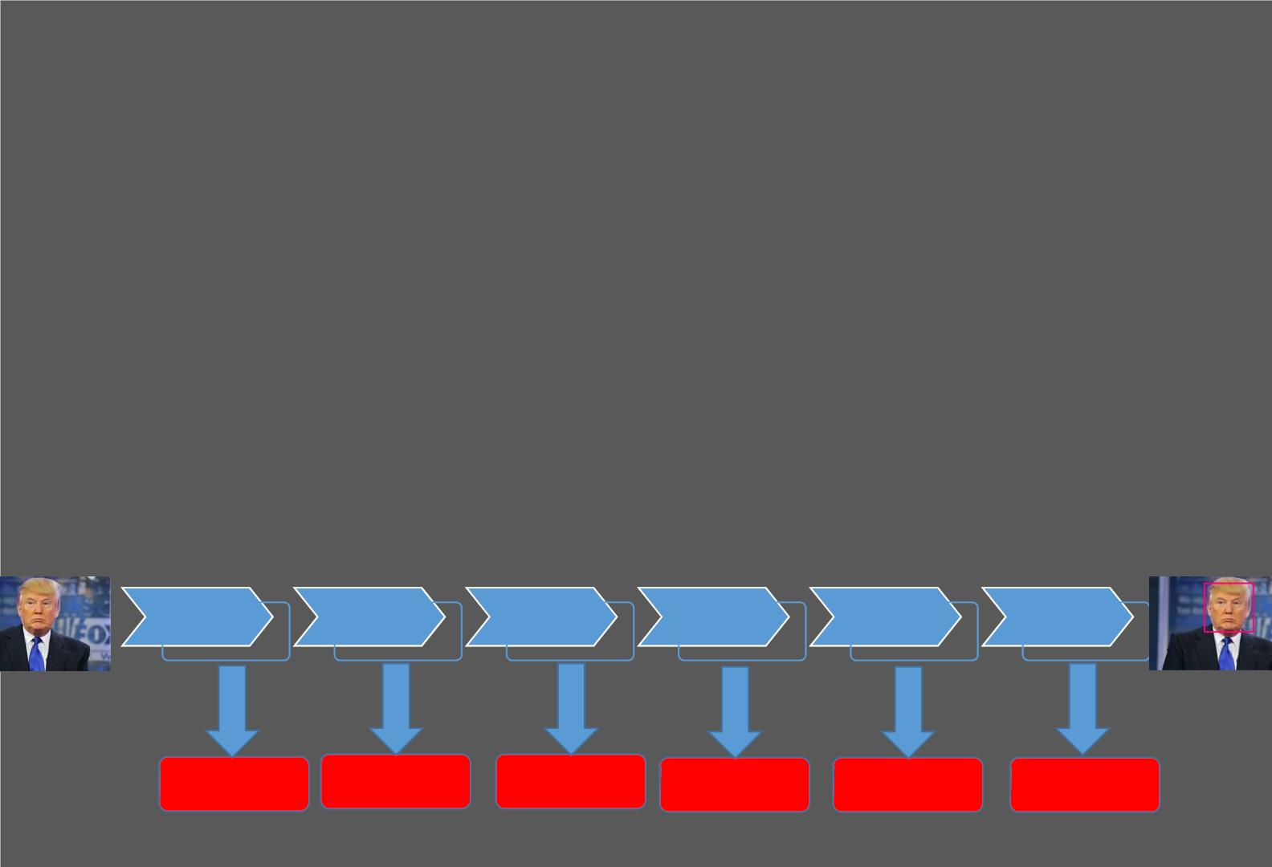
HAAR Classifiers Explained
. Think about this intuitively, if of those 6000 features, some will be more informative than others. What if we used the most informative features to first check whether the region can potentially have a face (false positives will be no big deal). Doing so eliminates the need for
calculating all 6000 features at once.
.This concept is called the Cascade of Classifiers - for face detection, the Viola Jones method used 38 stages.
Stage 1
Stage 2
Stage 3
Stage 4
Stage 5
Stage 6…38
1 Feature
10 Features
20 Features
25 Features
50 Features
No Face
No Face
No Face
No Face
No Face
No Face

Slide 25

List of OpenCV Pre-Trained Cascade Classifiers
Click Here - https://github.com/opencv/opencv/tree/master/data/haarcascades

Slide 26
HAAR Cascade Classifiers
As we saw in the previous section, we can extract features from an image and
use those features to classify objects.
What are HAAR Cascade Classifiers?
An object detection method that inputs Haar features into a series of classifiers (cascade) to identify objects in an image. They are trained to identify one type of object, however, we can use several of them in parallel e.g. detecting eyes and aces together.

Slide 27
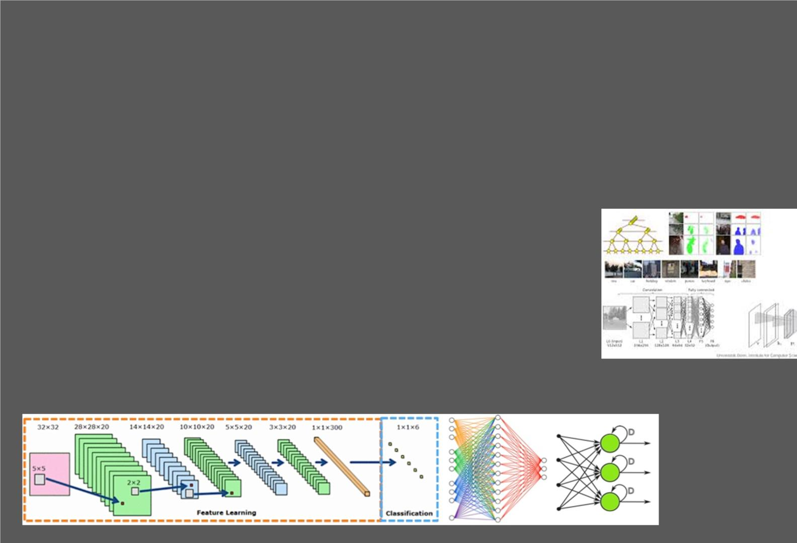
Current State of Computer Vision?
Object Recognition - Deep Belief and Convolution Neural Networks are changing everything!
Where to learn more?
Stanford CS231 class - cs231n.github.io
Café - caffe.berkeleyvision.org/tutorial
Deep Learning Tutorial - ufldl.stanford.edu/tutorial
Deep Learning Tutorial - deeplearning.net/reading-list/tutorials
Deep Learning Tutorial - www.deeplearningbook.org
Tensor Flow - www.tensorflow.org/versions/r0.11/tutorials/index.html

Slide 28

OpenCV in Mobile Apps & We b APIs?
API - Create a RESTful API using DJANGO or FLASK to bundle you OpenCV code
• PROS
• Can be accessed on any mobile phone app or on a PC/MAC
• Can be updated remotely (cloud based)
• Powerful as processing is off loaded
• CONS
• Requires internet connection to transfer images
• Will need to pay API cloud hosting
• Can’t do real time video based apps
Native Mobile – Use OpenCV natively (using wrappers for iOS and Android)
• PROS
• Can do real time video based apps
• No need to pay for cloud based storage
• CONS
• Can’t do heavy processing on mobile device
• More difficult than using OpenCV in python
iOS - http://docs.opencv.org/2.4/doc/tutorials/introduction/ios_install/ios_install.html
Android - http://blog.codeonion.com/2015/11/17/learning-the-packages-of-opencv-sdk-for-android/

